Slide 1
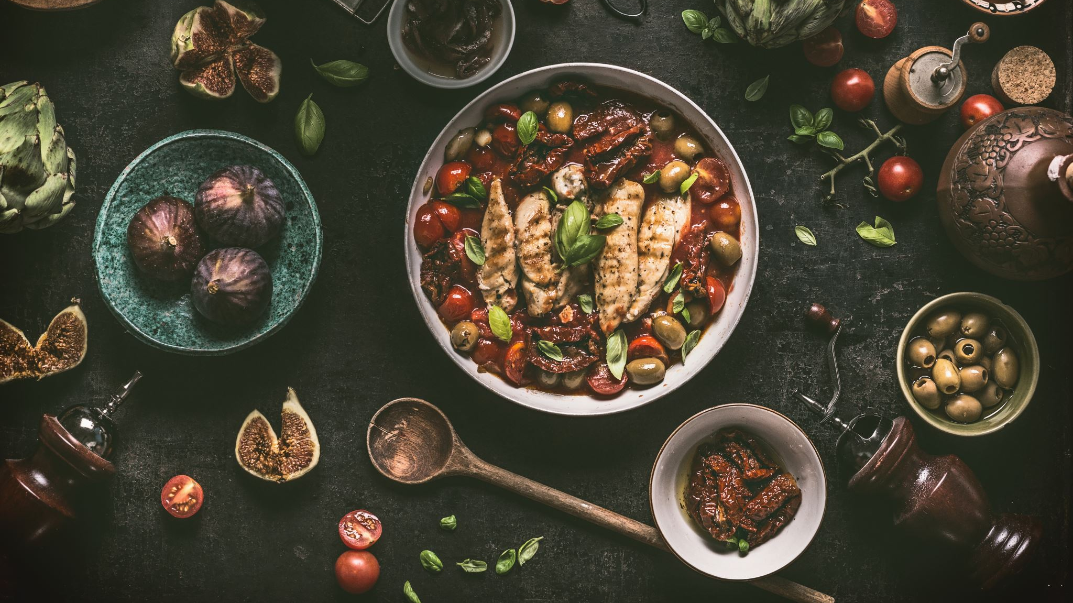
Food styling
Year 10 food tech

Slide 2
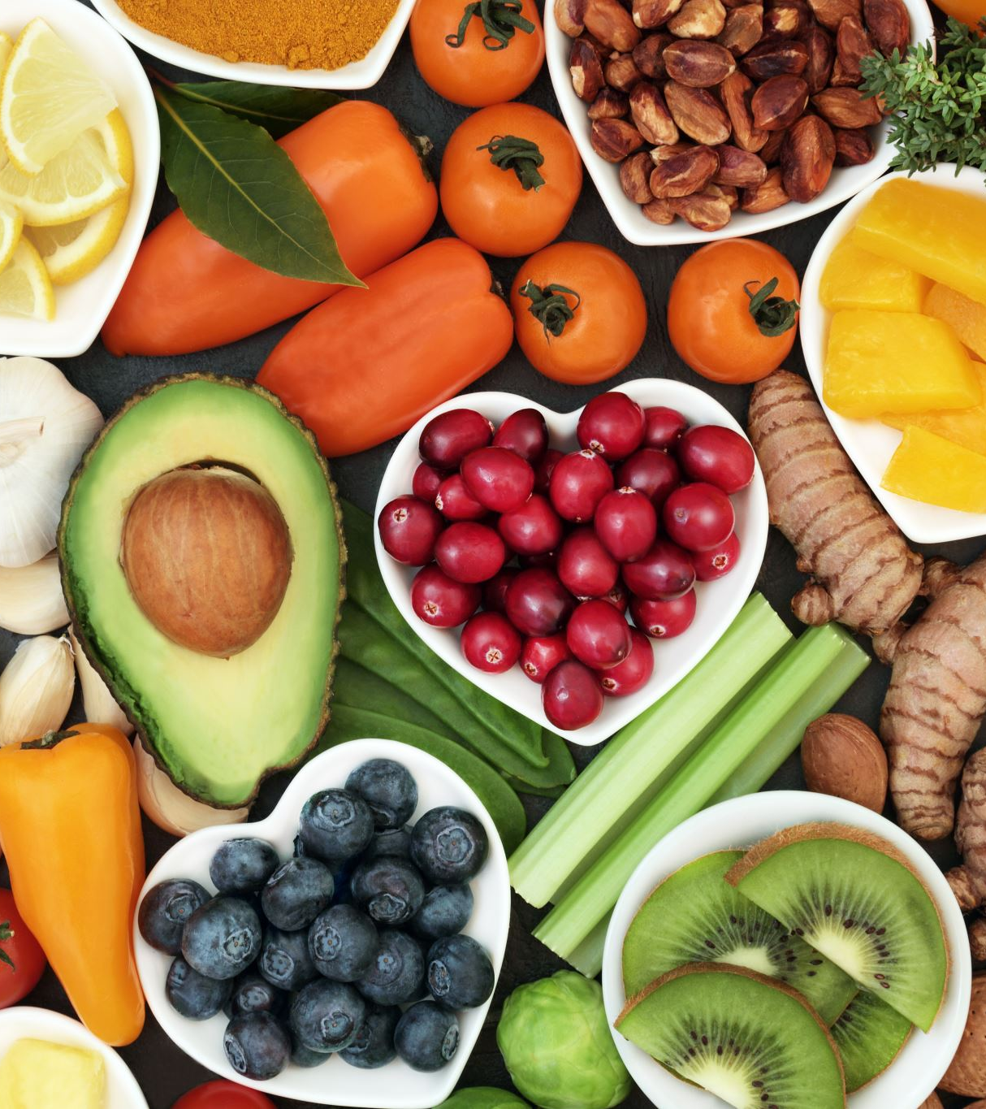
Learning Intentions and success criteria
Learning intention:
Students will learn about food styling and what is needed in order to create an aesthetically pleasing dish and how to take appropriate photos of the dish.
Students will learn about garnishes and which garnishes work with which dishes.
Success criteria:
I know how to garnish my dishes appropriately
I can style a dish in an aesthetically pleasing manner
I can take photos of my dishes when I need to.

Slide 3
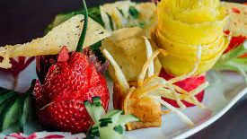
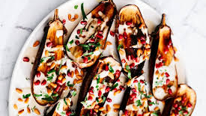
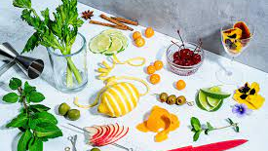
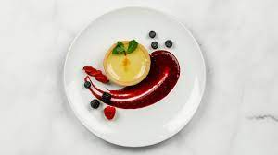
What is a Garnish?

Slide 4
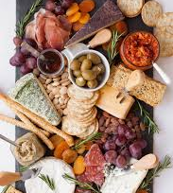
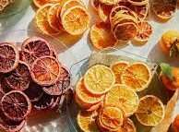
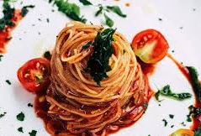
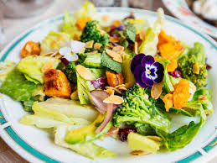
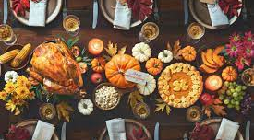
To garnish means to decorate or embellish something, especially food.
A garnish is an item or substance used as a decoration or embellishment accompanying a prepared food dish or drink. A garnish is usually edible and complements the flavours of the food.

Slide 5
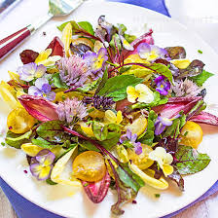
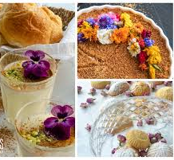
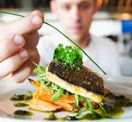
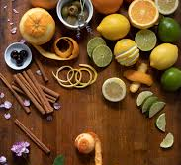
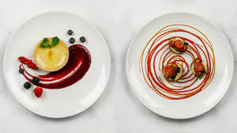
What are the different types of edible garnishes?

Slide 6
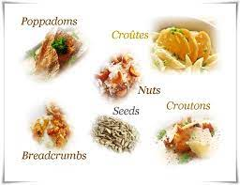
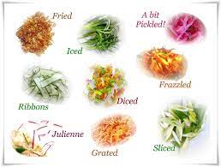
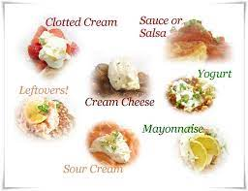
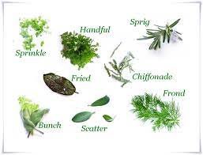
Herbs, such as parsley, rosemary, chives
Spices, such as paprika and cinnamon
Pickles
Nuts and seeds
Slices of fruit, such as whiles of lemon or fanned strawberries
Cream, piped or quenelles
Sugar art
Edible flowers

Slide 7
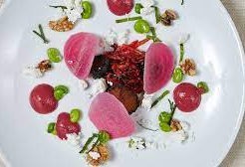
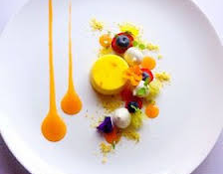
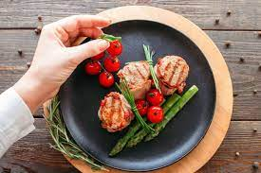
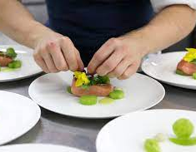
What does food plating mean?

Slide 8
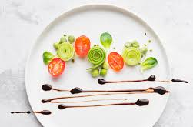
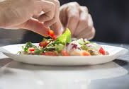
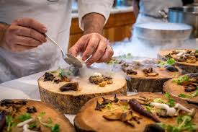
Food plating is the process of arranging and decorating food to enhance its presentation. Sauces and purees are often used to create visual interest as well as add to the flavour of the dish.
Remember! We eat with our eyes

Slide 9
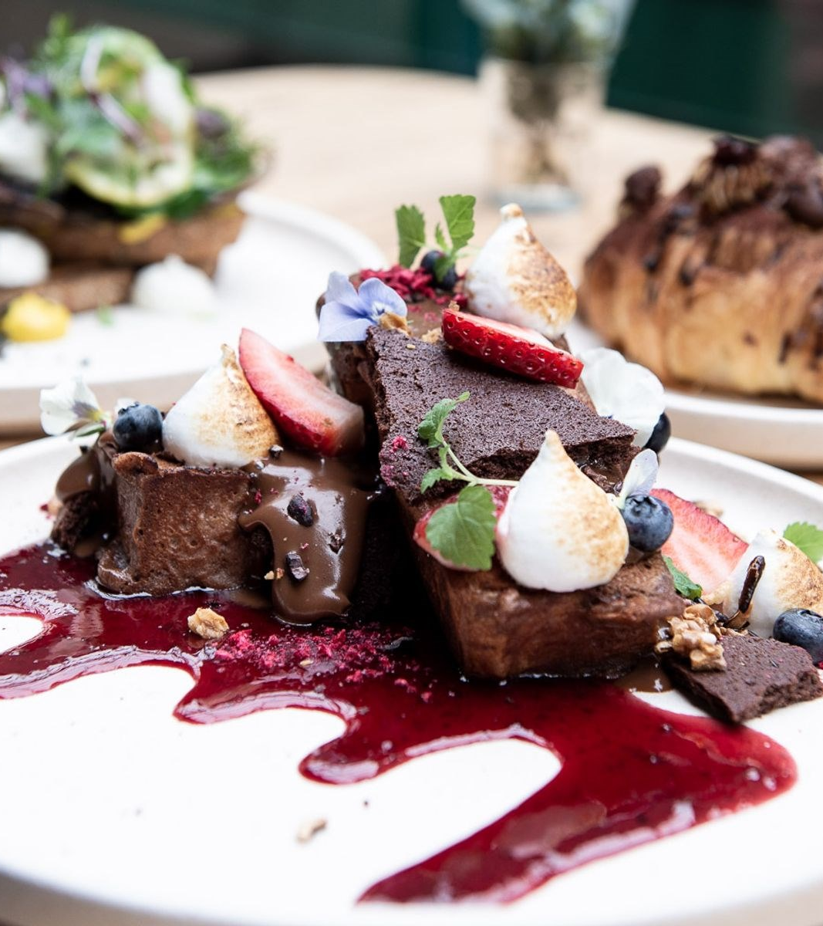
Some things we should consider whilst plating
Place your ingredients - as you begin plating the ingredients, picture the face of a clock. From the diner's point of view, the protein should be between 3 and 9, the starch or carbohydrate from 9 and 12, and the vegetable from 12 and 3
Choose the right plate - consider the size, colour and shape of the plate
Serve odd amounts of food - this is pleasing to the eye
Don't overcrowd the plate

Slide 10
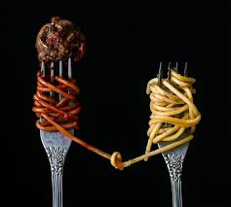
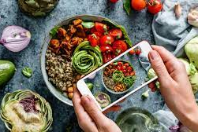
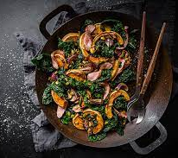
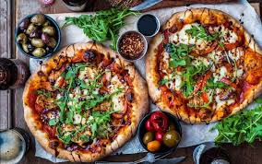
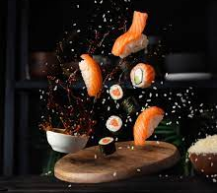
What to consider when photographing food
The photography of food has come a long way in recent years due to marketing and social media. Successful photography of food connects the dish with the viewer.
To take successful photos of food, the photographer should consider the angle from which the picture is taken, the story of the dish - with the setup and props and the lighting used.

Slide 11
